Slide 1
Local Mojaloop
Deploy fsps with sdk adapter

Slide 2
Agenda
Architecture
Start a Mojaloop
Onboarding Custom FSPs instance (backend more sdk) and a simulador
Execute transfers
Next Steps

Slide 3
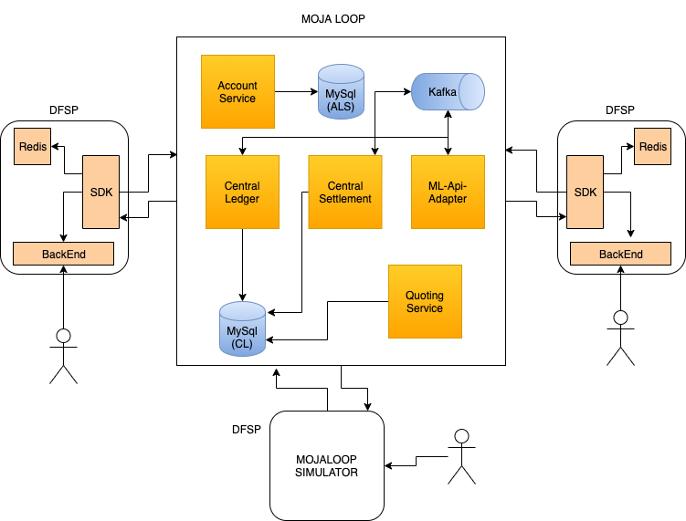
Architecture

Slide 4
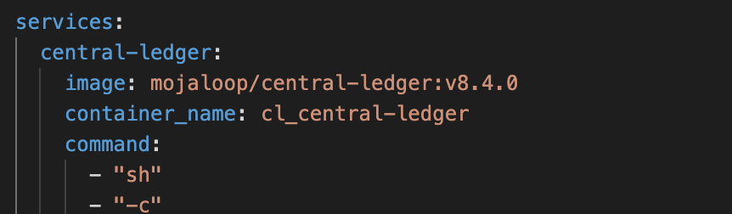
Start Mojaloop
We use docker-compose to start a local mojaloop (basic services) , dfsps and a mojaloop simulator.
$ docker-compose up

Slide 5
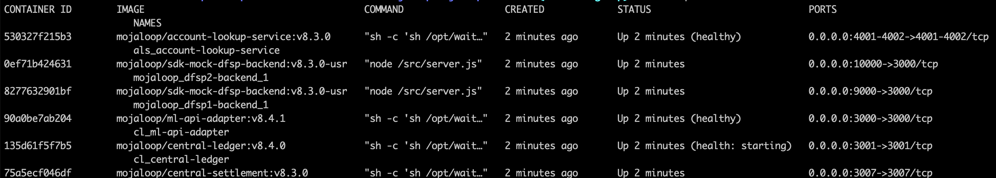
Service up and running
We can see all services
$ docker ps

Slide 6
Set up Mojaloop
Preload some test data
$ sh scripts/setupDockerCompose-HubAccount.sh
$ sh scripts/setupDockerCompose-OracleOnboarding.sh

Slide 7
Onboarding Custom FSPs instance
Each custom FSP instance will be initialized through a script. This script executes a postman collection.
JWS, ILP and TLS will be deactivated for executing simples tests.
FSPs have auto accept party and quotes for simplicity

Slide 8
Onboarding Custom FSPs instance
Create a CitiBank DFSP (use SDK + backend)
$ sh scripts/setupDockerCompose-DFSP-CITIBANK.sh
Create a Bank Of America DFSP (use SDK + backend)
$ sh scripts/setupDockerCompose-DFSP-BANK-OF-AMERICA.sh
Create a Simulator DFSP (implement mojaloop api)
$ sh scripts/setupDockerCompose-DFSP-SIMULATOR.sh

Slide 9
Onboarding Custom FSPs instance
Add MSISDN for CitiBank DFSP
$ sh scripts/setupDockerCompose-DFSP-CITIBANK-MSISDN.sh
Registered Participant 123456789
Add MSISDN for Bank Of America DFSP
$ sh scripts/setupDockerCompose-DFSP-BANK-OF-AMERICA-MSISDN.sh
Registered Participant 987654321

Slide 10
Onboarding Custom FSPs instance
Add MSISDN for Simulator
$ sh scripts/setupDockerCompose-DFSP-SIMULATOR-MSISDN.sh
Registered Participant 333333333

Slide 11
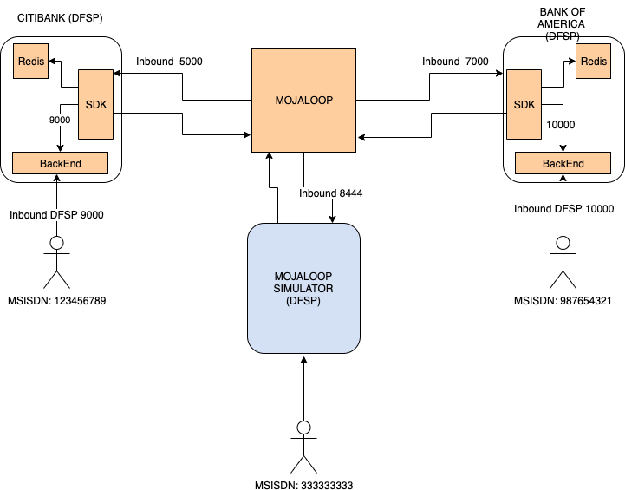

Slide 12
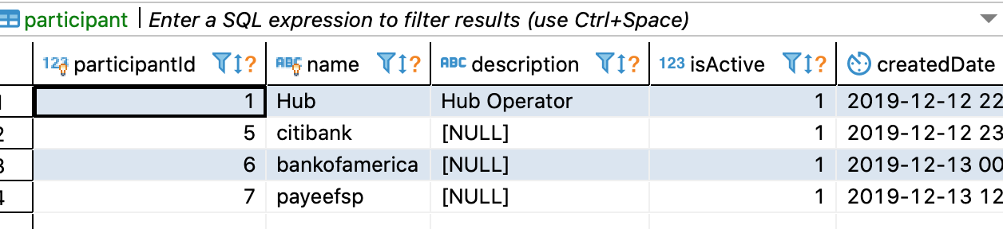
Onboarding Custom FSPs instance
We can inspect the central-ledger database. Table participant

Slide 13
Execute Transfers
We’ll transfer USD 100 from MSIDNS 123456789 (CITIBANK) to MSIDNS 987654321 (Bank Of America)
<<demo>> execute url from command line
curl -v -X POST http://localhost:9000/send ...

Slide 14
Execute Transfers
We’ll transfer USD 150 from MSIDNS 987654321 (Bank Of America) to MSIDNS 123456789 (CITIBANK)
<<demo>> execute url from command line
curl -v -X POST http://localhost:10000/send ...

Slide 15
Execute Transfers
We’ll transfer USD 90 from MSIDNS 123456789 (CITIBANK) to MSIDNS 333333333 (Simulator)
<<demo>> execute url from command line
curl -v -X POST http://localhost:9000/send ...

Slide 16
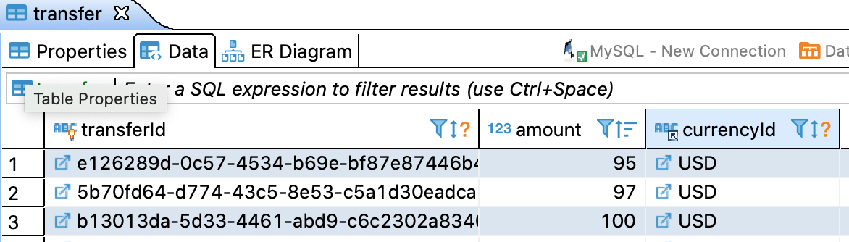
Transfer Results
We can inspect the central-ledger database. Table transfer

Slide 17
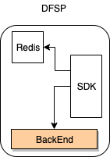
Next Steps
The backend can be anything that implements the simplified DFSP API defined by the SDK.

Slide 18
Thanks!

